Slide 1
An introduction to Difference-in-Differences and Synthetic Control Methods for Epidemiologists
09 July 2021
SER 54th Annual Meeting Workshop
Roch Nianogo and Tarik Benmarhnia

Slide 2
Agenda for today
Introductions
Part I ~ 80 min
Q&A
Break
Part II ~ 90-120 min
Q&A
End

Slide 3
Outline – Part 1
Causal inference, natural experiments and quasi-experimental methods
Difference-in-differences methods
Interrupted Time Series
Synthetic Control Methods
More advanced topics

Slide 4
Workshop Objectives
Understand the conceptual foundations of quasi-experimental methods based on the timing of a natural experiment
Understanding how Difference-in-Differences (DID), Interrupted Time Series (ITS) and Synthetic Control Methods (SCM) work and their specific identification assumptions.
Being able to implement (in R) DID, ITS and SCM in different settings, interpret estimands of interest and check/visualize possible assumptions’ violations

Slide 5
Randomization as a solution to deal with confounding
Randomization has been proposed as a solution to deal with confounding
  Complying with exchangeability and substitution between exposed and non-exposed to the policy/treatment
  For both measured & unmeasured confounding

Slide 6
Ideal randomized experiments
What makes an ideal randomized experiment:
  No loss to follow-up,
  Full adherence to the assigned treatment over the duration of the study,
  A single version of treatment, and double-blind assignment
Ideal randomized experiments are unrealistic but useful to introduce some key concepts for causal inference

Slide 7
The idea behind randomization
How do RCT work …
Randomization can be analyzed as an “Instrumental Variable”
The overall aim is to deal with measured and unmeasured confounding in observational studies by using an instrumental variable
The problem: in many cases RCT are not feasible due costs, scale or ethical objections
Or because it is simply too late ..
C and U
IV
X
Y

Slide 8
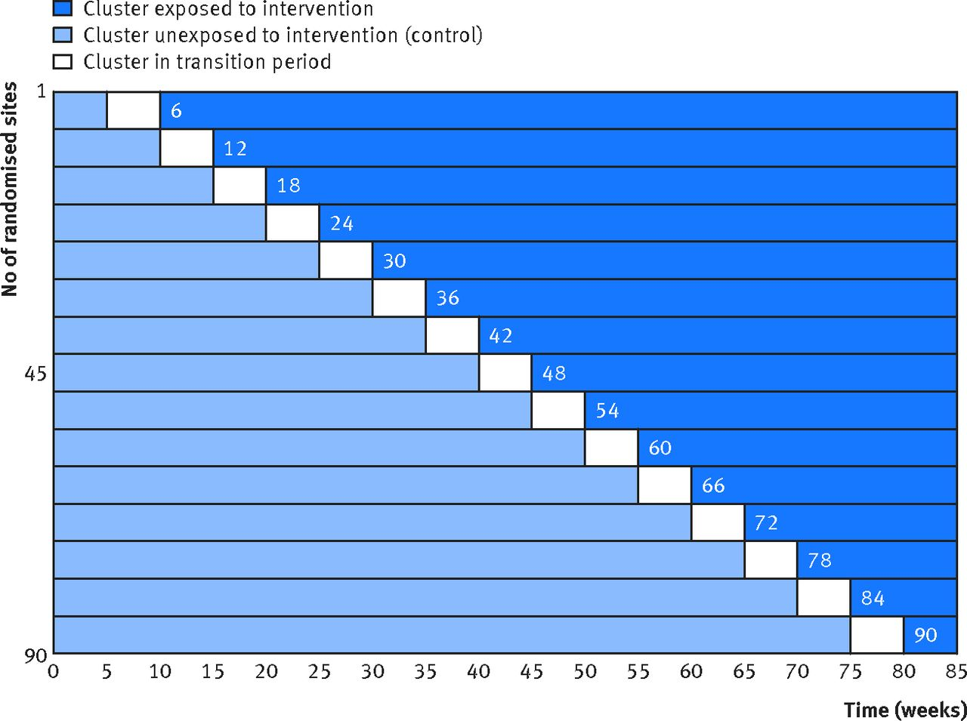
Different types of RCTs
Two-arm, parallel design
Planned cross-over design
Factorial design
Cluster randomized trials
Stepped Wedge Designs
  Based on the timing of the intervention
Hemming, Karla, et al. "The stepped wedge cluster randomised trial: rationale, design, analysis, and reporting." Bmj 350 (2015): h391.
Hulley et al. Designing Clinical Research. 2nd Edition. Lippincott Williams & Wilkins, 2001

Slide 9
Using Natural experiments
By capitalizing on natural experiments, Quasi-experimental methods (QEM) can be used as alternatives to experimental methods to provide causal estimates from observational studies.
The term quasi-experiment refers to
  “experiments that have treatments, outcome measures, and experimental units, but do not use random assignment to create the comparisons from which treatment-caused change is inferred” (Cook et al. 1979)
Different QEM, different configurations, different assumptions to draw causal inference
To deal with both measured and unmeasured confounding

Slide 10
Example of natural experiments not only for policy evaluation
Public policies:
  Smoking ban
  Legalization of marijuana
Conditional Cash Transfers
Natural Hazards
  Earthquakes
  Wildfires
2 main types of natural experiments
Timing of the intervention
Eligibility to a specific policy (e.g. age for vaccination) and other IV strategies

Slide 11
Difference-in-differences

Slide 12
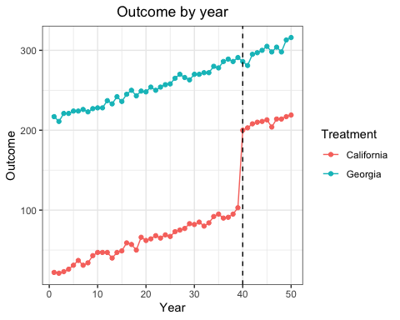
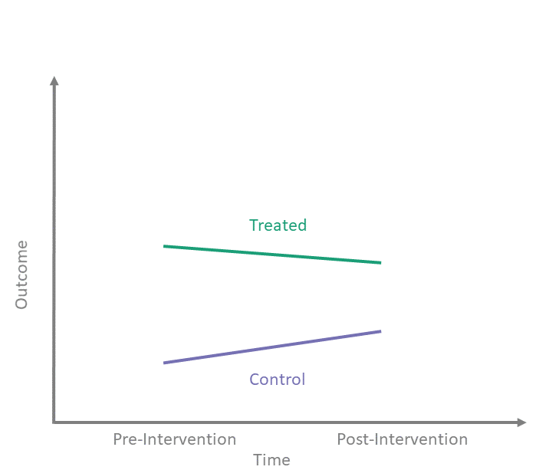
The difference-in-differences idea
By Bret Zeldow and Laura Hatfield
Nianogo, Benmarhnia and O’Neill [In preparation]

Slide 13


Difference-in-differences
The standard approach
To estimate a causal effect
Simple Regression modeling approach (with 2 groups)
  E[Y | a, t,did] = β₀ + β₁a + β₂t + β₃did
  Where:
    a represents the group with the policy
    t epresents the period after the policy implementation
    DID is the interaction between a and t

Slide 14
How does it work?
T=0
T=1
β₀ | β₀ ₊ β₁
Β’₀ ₊ β₂ | Β’₀ ₊ β’₁ ₊ β’₂ ₊ β₃
A=0
A=1
0 0
1 0
0 1
1 1
  E[Y | a, t,did] = β₀ + β₁t + β₂a + β₃ [a*t]
You can also include more complex time trends
Like a double fixed effect

Slide 15
DID assumptions
The key assumptions of the DiD analysis are:
  The trend in the control group represents a good approximation for the counterfactual trend of the treated group in the absence of the treatment.
  Common Shock Assumption
  No spillover

Slide 16
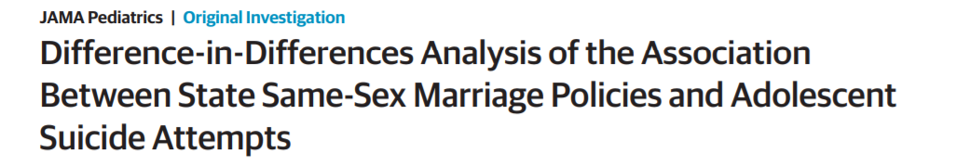
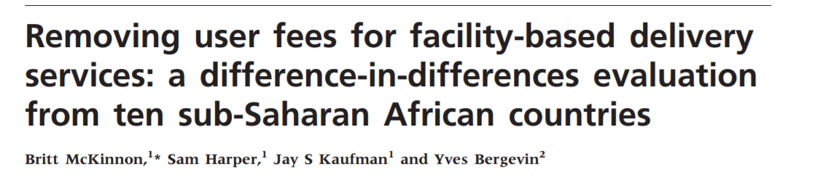
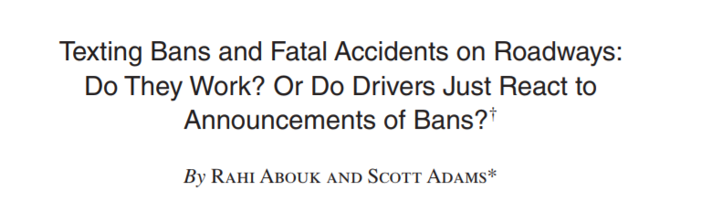
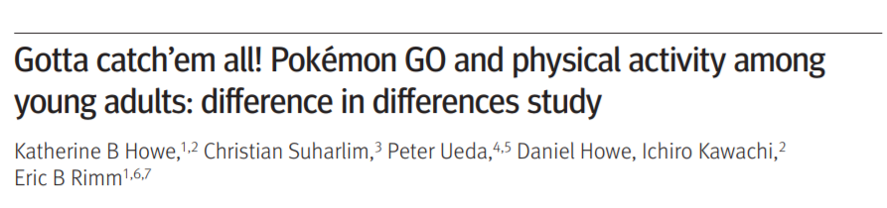
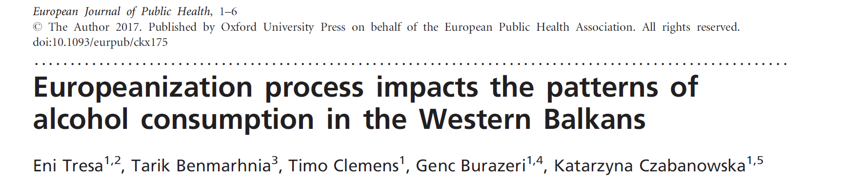
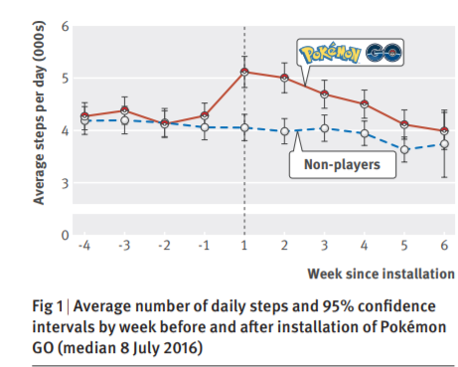
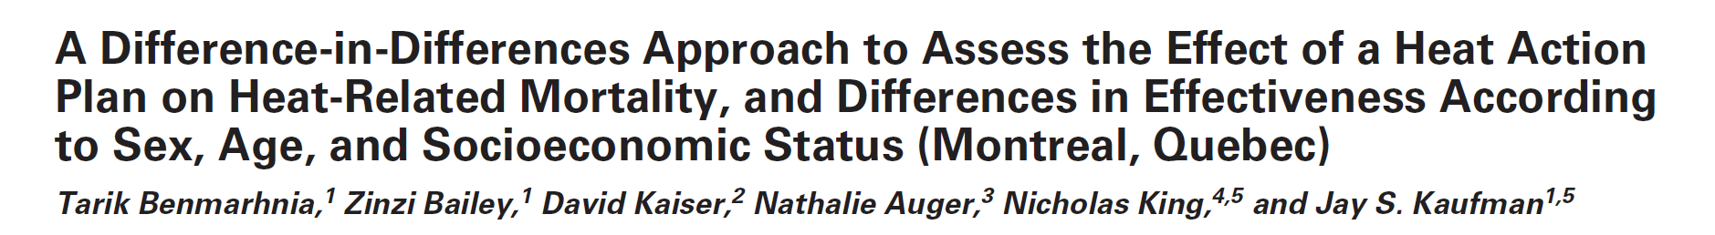
Many applications

Slide 17
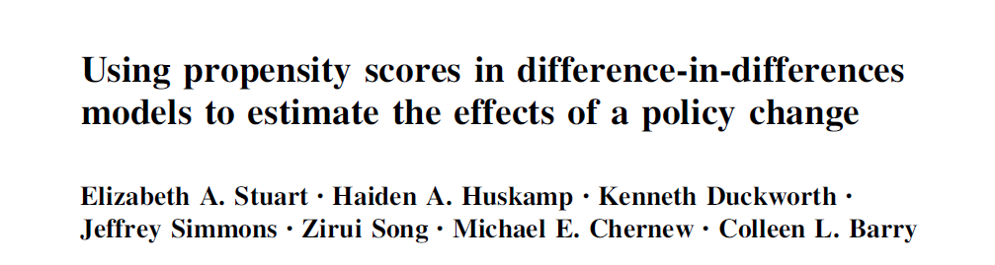
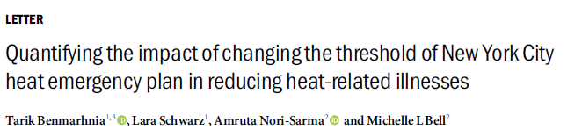

DiD coupled with Propensity Score methods
When multiple control groups are available, it is possible to use available information on time-varying and time-fixed confounders
We can use propensity score matching and IPTW for example
By doing so, we aim at identifying similar observations at each time point in the control groups

Slide 18
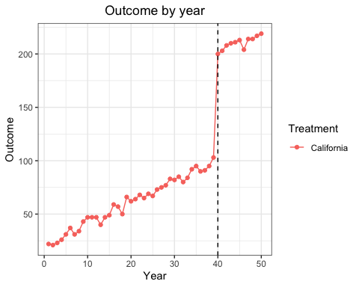
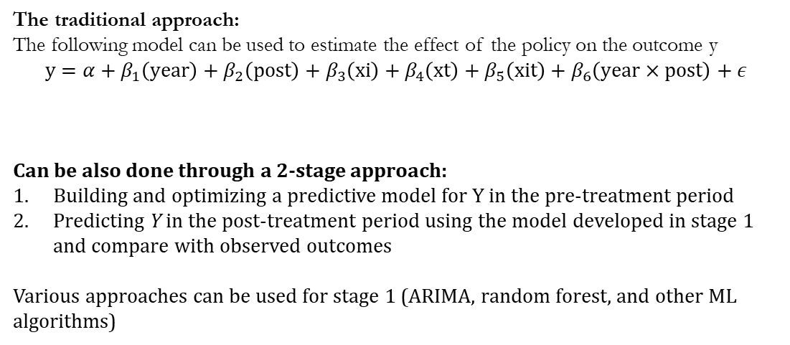
Interrupted time series:
DID without control groups
Estimation
The traditional approach:
The following model can be used to estimate the effect of the policy on the outcome y
$$y=α+β_{1}\left(year\right)+β_{2}\left(post\right)+β_{3}\left(xi\right)+β_{4}\left(xt\right)+β_{5}\left(xit\right)+β_{6}\left(year×post\right)+ε$$
Can be also done through a 2-stage approach:
Building and optimizing a predictive model for Y in the pre-treatment period
Predicting Y in the post-treatment period using the model developed in stage 1 and compare with observed outcomes
Various approaches can be used for stage 1 (ARIMA, random forest, and other ML algorithms)

Slide 19
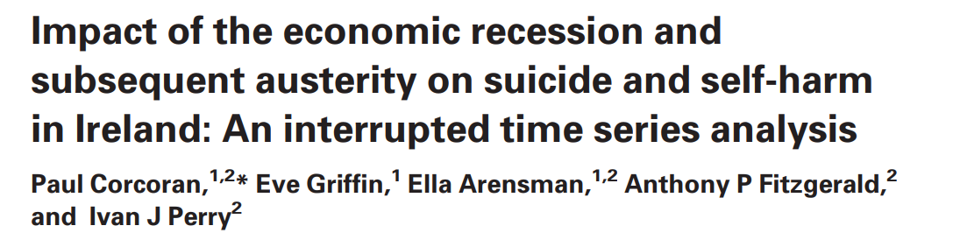
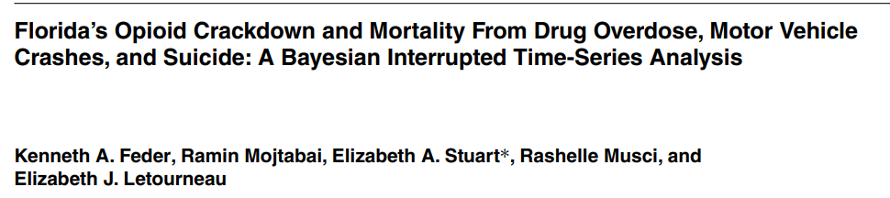
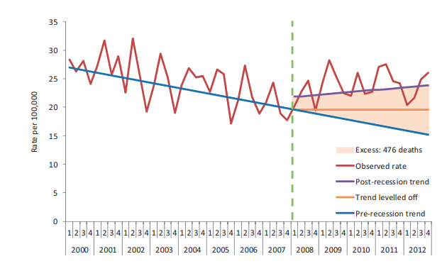
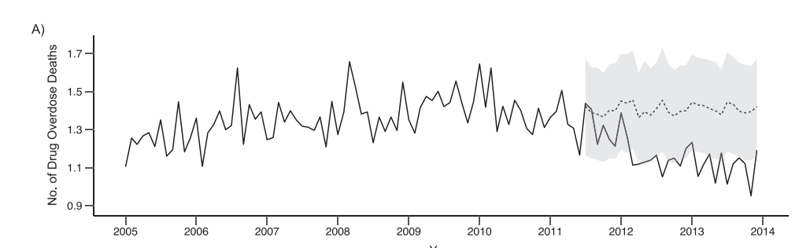
ITS examples

Slide 20
Controlled ITS or DID?
When using one (or more) control group.s, there is no fundamental distinction between Controlled ITS and DID models
They yield the same counterfactuals and identify the same treatment effects.
The terminology simply varies across disciplines
Fry, C. E., & Hatfield, L. A. Birds of a feather flock together: Comparing controlled pre–post designs. Health Services Research. https://onlinelibrary.wiley.com/doi/epdf/10.1111/1475-6773.13697

Slide 21
synthetic control methods

Slide 22
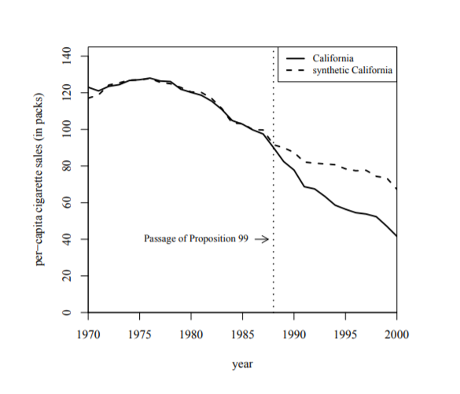
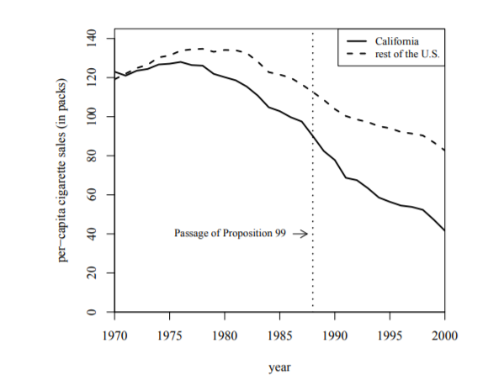
The intuition
When using a DID, it is sometimes difficult to establish whether the parallel trends assumption is met and whether the control group is a sufficiently accurate representation of what would have happened in the treated area without the intervention
Synthetic control methodology (SCM) allows the construction of a counterfactual by selecting a weighted average of the outcome variable from a group of units similar to the treated unit
The intuition behind this method using the original paper by Abadie et al. 2010

Slide 23
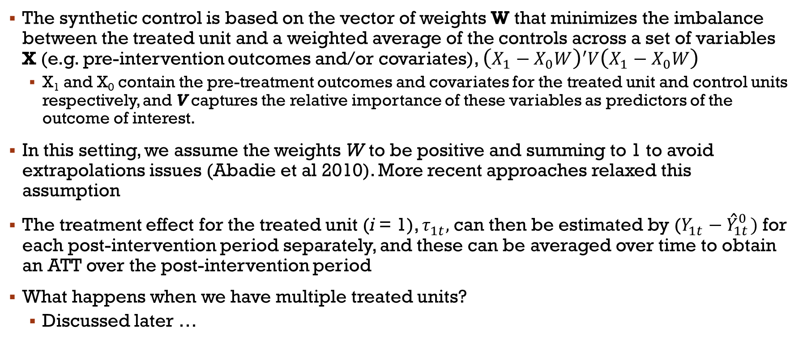
How Does it work?
The synthetic control is based on the vector of weights W that minimizes the imbalance between the treated unit and a weighted average of the controls across a set of variables X (e.g. pre-intervention outcomes and/or covariates), ${\left(X_{1}−X_{0}W\right)}^{′}V\left(X_{1}−X_{0}W\right)$
  X₁ and X₀ contain the pre-treatment outcomes and covariates for the treated unit and control units respectively, and V captures the relative importance of these variables as predictors of the outcome of interest.
In this setting, we assume the weights W to be positive and summing to 1 to avoid extrapolations issues (Abadie et al 2010). More recent approaches relaxed this assumption
The treatment effect for the treated unit (i = 1), $τ_{1t},$ can then be estimated by ($Y_{1t}^{ }−{\hat{Y}}_{1t}^{0 })$ for each post-intervention period separately, and these can be averaged over time to obtain an ATT over the post-intervention period
What happens when we have multiple treated units?
  Discussed later …

Slide 24
Steps in conducting a Synthetic control study
Ensure the theory behind the intervention is well understood. Develop or present a conceptual model to make the theory transparent.
  To ensure areas that have also been exposed to a similar intervention are excluded from the pool of potential controls
Identify potential control units that are plausibly eligible
Develop the synthetic control.
  An optimization procedure using the outcome variables from the potential control areas to select the best weighting of units from the donor pool to create a synthetic control
Run outcome analysis and present results
Run robustness checks

Slide 25

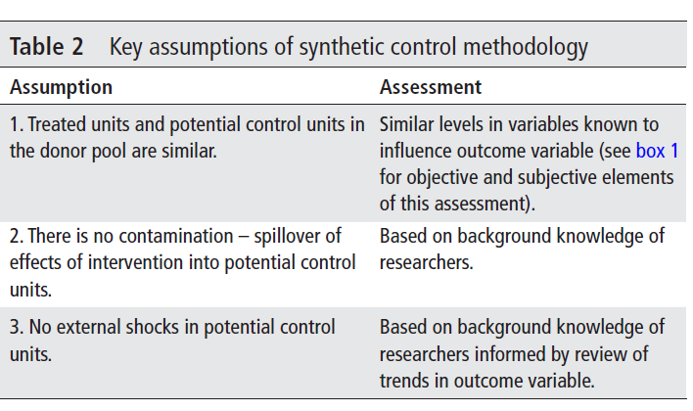
Key assumptions

Slide 26

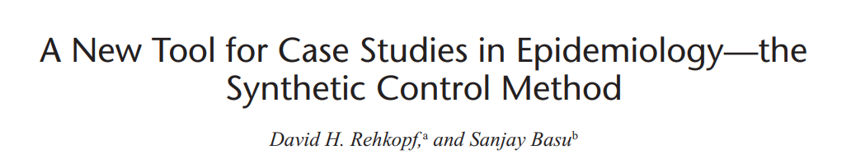
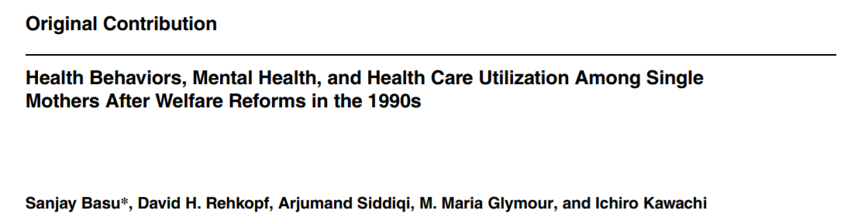
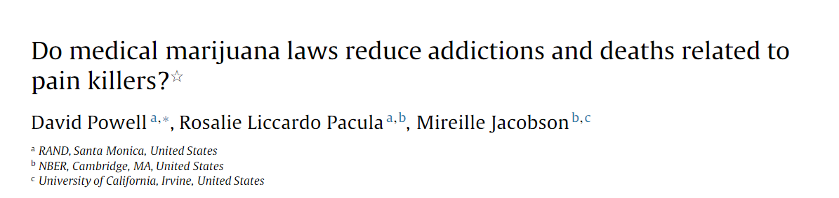
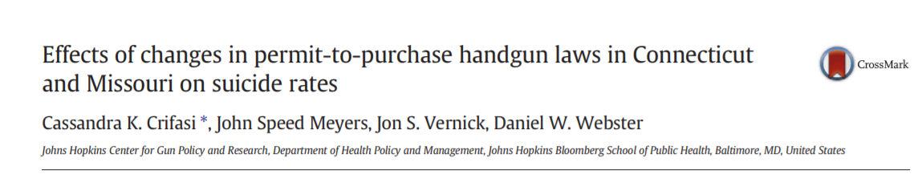
Examples

Slide 27
Overview:
Comparing different approaches to evaluate natural experiments based on the timing of the intervention
Uncontrolled before and after designs
  Single or multiple measurements
Interrupted time series design
Controlled Before and after with single measurements
Difference-in-Differences
Augmented DID approaches
  With propensity score methods
Synthetic Control Methods
No Control Group
With one Control Group
With >1 Control Groups

Slide 28
Multiple treated groups
When dealing with multiple treated units, there are two distinct settings:
  All treated units received the intervention of interest at the same time
    Covered today
  Treated units received the intervention at different times
    Not covered today
When multiple units receive the intervention at the same time:
  A simple approach is to estimate a separate ATT for each treated unit and then conduct a meta-analysis to get a pooled estimate (and information about heterogeneity across units)
  Or aggregate the treated units and form a synthetic control for the aggregated treated unit (Acemoglu et al. 2013; Dube and Zipperer, 2015)

Slide 29
Extensions of traditional SC: Generalized Synthetic Control (GSC)
Xu et al. 2017 proposed generalized synthetic control (GSC): estimates the average treatment effect on the treated using time-series cross sectional data
Improves efficiency and interpretability from SC, and can be used with multiple treated units and time varying confounders
GSC overcomes limitations in SC:
Only unbiased when weights yield exact balance on lagged outcomes (and unidirectional weights)
Only handles one treated unit at a time
Non-parametric: no formal measures of variance
Notes:
Extensions to overcome limitations - we will focus on gsynth

Slide 30
Advantages of GSC
Traditional regression methods and SC are not well suited to estimate health impacts of extreme weather events (drought, heat wave, wildfire)
Time varying confounding: (e.g. temperature, air pollution, other weather events)
Widespread exposure - multiple exposed units
Notes:
SC does not handle time varying confounding well
Case-cross over, time series, excess mortality risk are some common methods
Exess mortality - frequent detailed data
Case cross-over only useful for acute events with brief effects

Slide 31

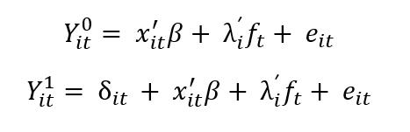
Estimation Steps
Estimation can be thought of as an out of sample prediction:
Estimate an interactive fixed effects model using only control group data to obtain latent factors
Project factor loadings onto each of these factors for the treated unit
Treated counterfactuals are estimated based on the estimated factors and factor loadings
D_{it} treatment indicator
x_{it} observed covariates
f_{t} latent factors
λ_{i} factor loadings
Notes:
The unobserved treatment free potential outcome of the treated units in the post-treatment period is imputed in three steps

Slide 32
Case Study: 2007 Southern California Wildfires on respiratory hospitalizations [Sheridan et al. ]
As the climate changes, wildfires are expected to increase in frequency, intensity and duration (especially in California)
In this case study we use:
Satellite based smoke plume data and burn area data to classify wildfire exposure
OSHPD respiratory hospitalization data by zip code for outcome

Slide 33
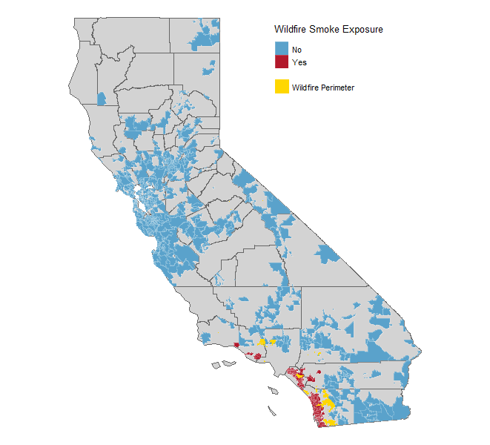
Results
Out of 1779 zip code tabulation areas in California
685 were included:
130 exposed
555 unexposed
Map of California zip codes exposed to wildfire smoke week of October 20th 2007.

Slide 34
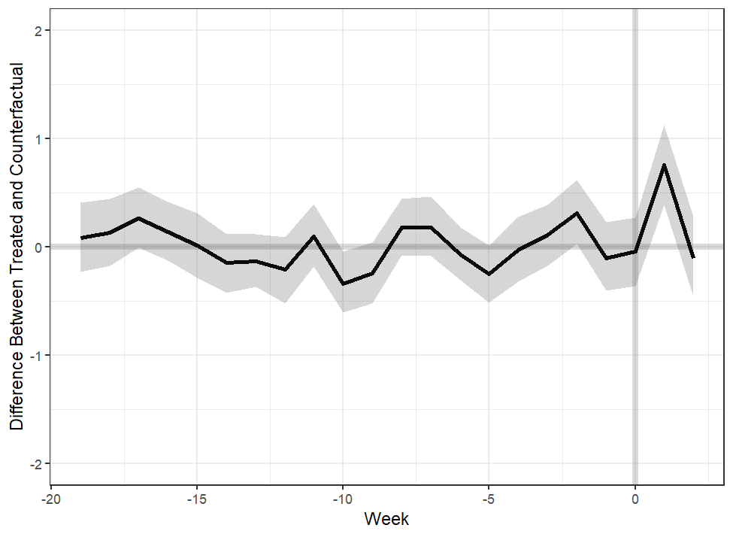
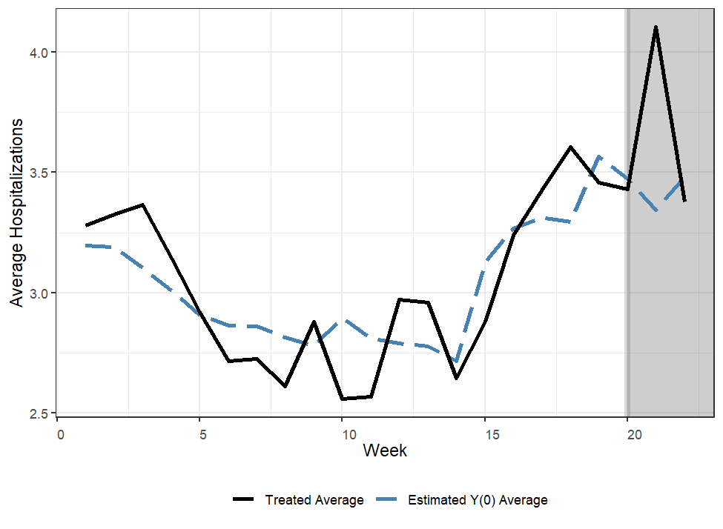
Results
We found an 18% (95%CI: 10%-29%) average increase in respiratory hospitalizations as a result of the wildfire storm

Slide 35
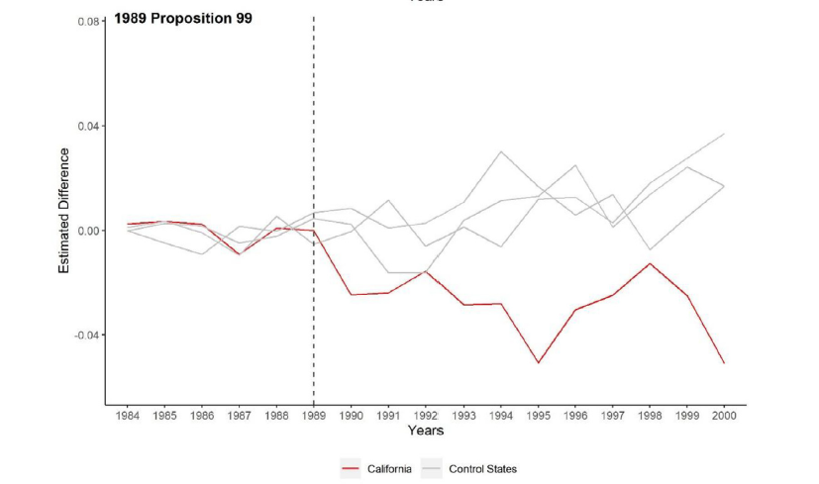
The importance of falsification tests
Permutation tests
Many assumptions cannot be checked empirically
  It is therefore important to design a set of falsification/placebo tests to improve the inference of interest
Negative control approaches
  Lipsitch M et al. (2012): Negative controls: a tool for detecting confounding and bias in observational studies.
Sheridan et al. "Evaluating the impact of the California 1995 smoke-free workplace law on population smoking prevalence using a synthetic control method." Preventive medicine reports 19 (2020): 101164.

Slide 36
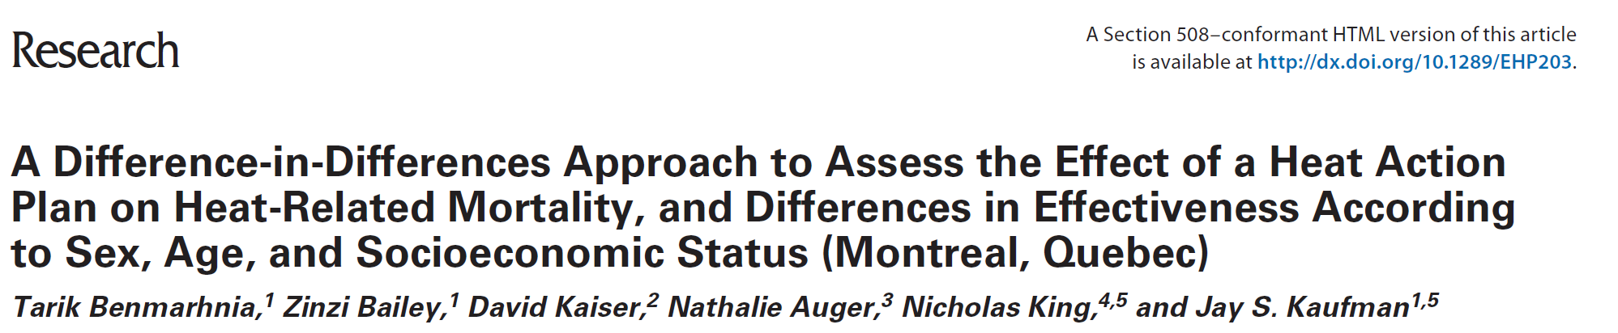

The Montreal heat warning system
  Implemented in 2004
  ‘active watch’ alert level, when daily max temperatures exceed 30°C
  Focus on vulnerable populations
    Age
    SES
    Gender as a placebo

Slide 37
The analytical Approach:
Assigning days (the unit of analysis) to two groups: an “intervention” group that meets an eligibility criterion and a “non-intervention” group that does not.
the “intervention” group: if ‘active watch’ alert level is present (heat wave days)
The non-intervention group: non heat wave days
The counterfactual quantity being estimated is:
  The difference in the daily number of deaths between intervention (heat wave) and non-intervention (non-heat wave) days in the post-2004 period, had the HAP not been implemented
Notes:
Fixed effect approach for time trends

Slide 38
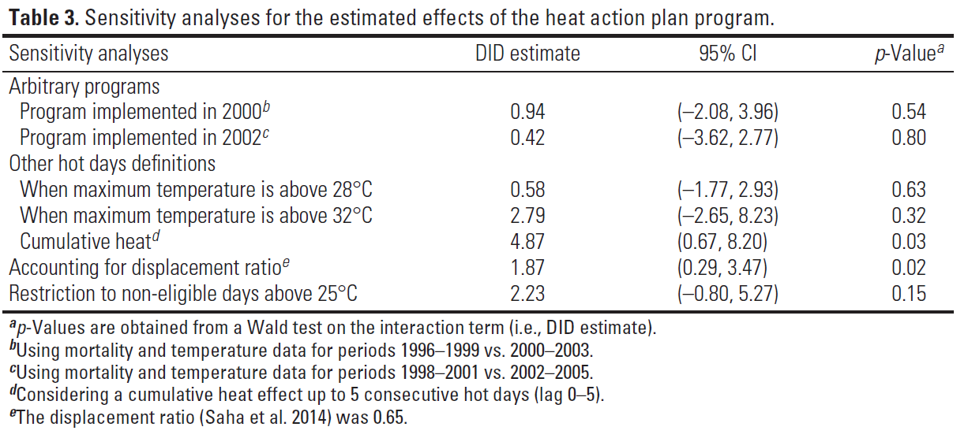
Sensitivity analyses

Slide 39
Topics not discussed today
Multiple treated units at different times
  A very active area of research
  Goodman-Bacon (2018) proposed a solution based on a weighted average of all possible DID estimators (using some groups multiple times) in the sample of interest. This approach requires an additional identifying assumption of time-invariant treatment effects.
  Callaway and Sant’Anna (2020) proposed an analytical solution for such case where there are more than two time periods and units that can become treated at different points in time while relaxing the time-invariant treatment effects assumption
Multi-stage interventions
The Scale of interest
  Important to think about the scale of the interaction term
    When Is Parallel Trends Sensitive to Functional Form? (Roth and Sant’Anna, 2021)
Lagged/delayed effects
  Many available tools

Slide 40
Designing a study capitalizing on the timing of an intervention
When designing a study in which the timing of an intervention is capitalized on, we recommend to undertake the three following steps
Define a clear research question, ideally with a well-defined intervention with specific implementation time and targeted population;
  The target trial framework which considers the design of an ideal randomized experiment, can be helpful in framing the study and the target causal estimand of interest.
Propose an identification strategy about how we can exploit the setting of the intervention implementation of interest to estimate the targeted causal quantity of interest (estimand) and identify possible falsifications tests
Propose an estimation strategy which often relates to the statistical or modelling approach (i.e. estimator) that we will use to obtain a given estimate (e.g. regression coefficient) to quantitatively represent the targeted estimand of interest (i.e. ATT).

Slide 41
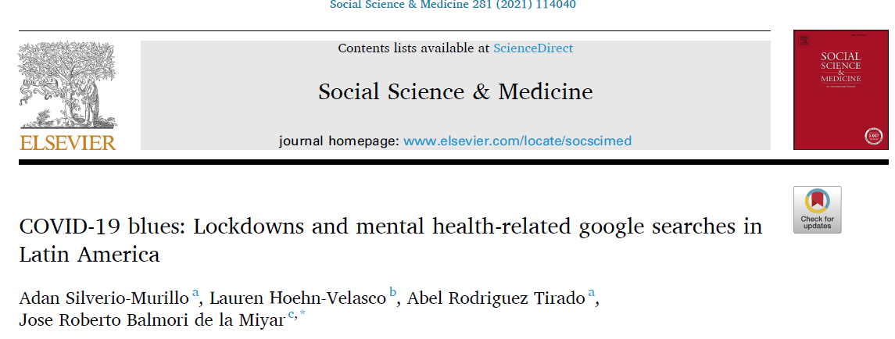
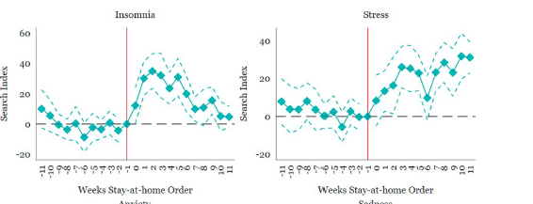
Step by step hypothetical example

Slide 42
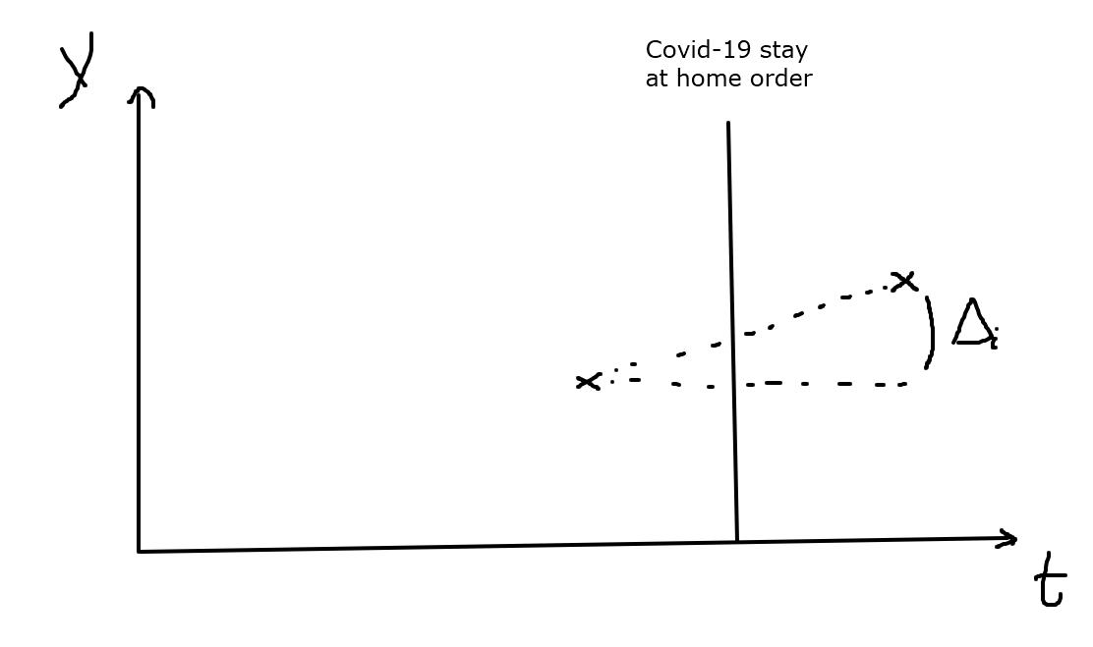
Simple before and after design

Slide 43
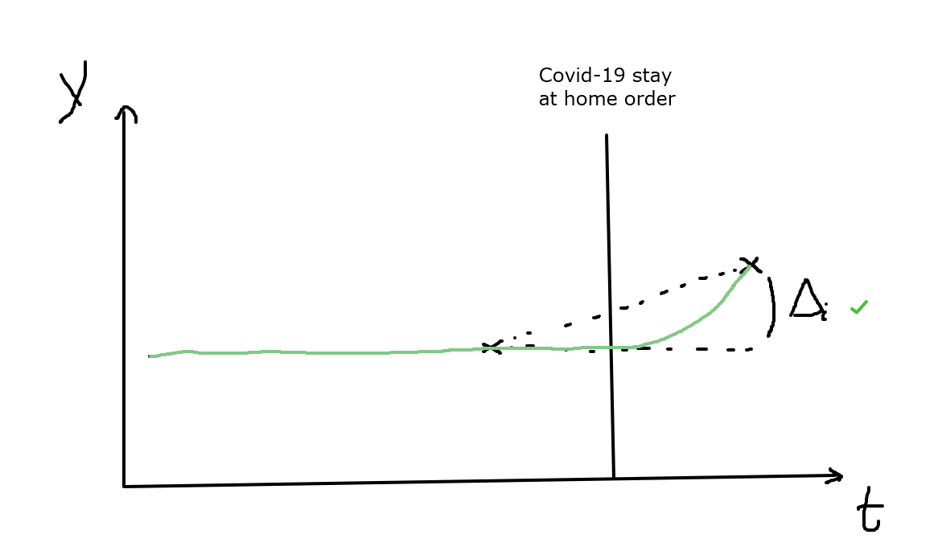
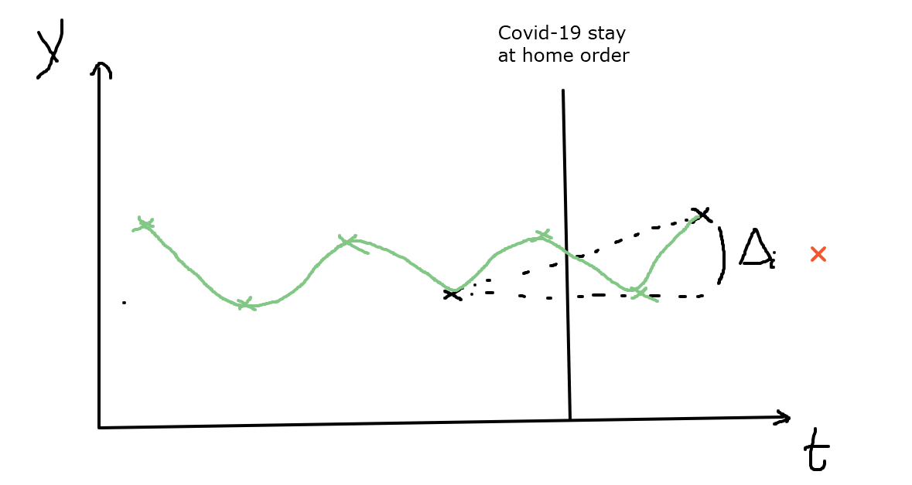
What could go wrong

Slide 44
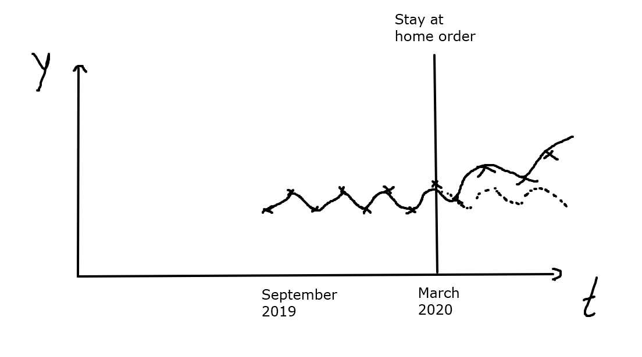
Using an ITS approach

Slide 45
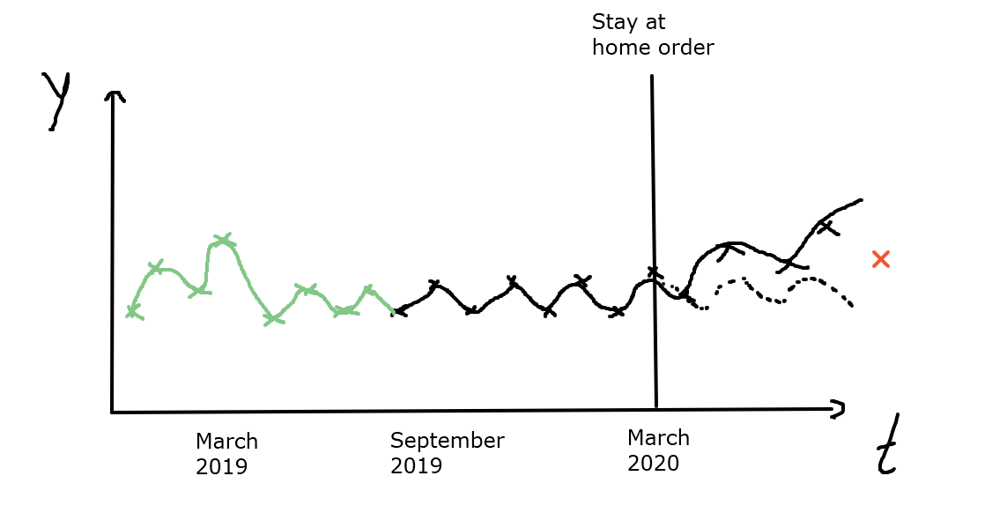
What could go wrong

Slide 46
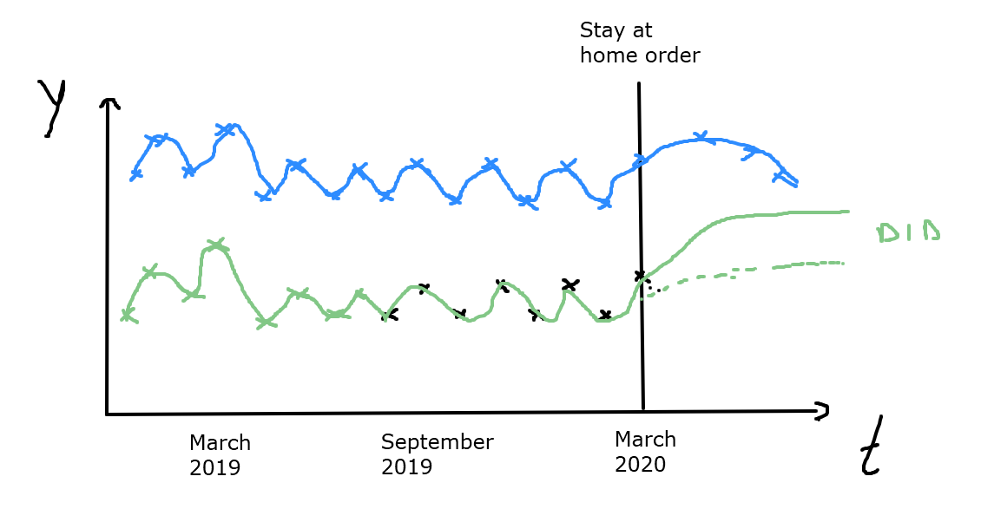
Solution: DID or CITS
If you have an eligible control group (with PT)

Slide 47
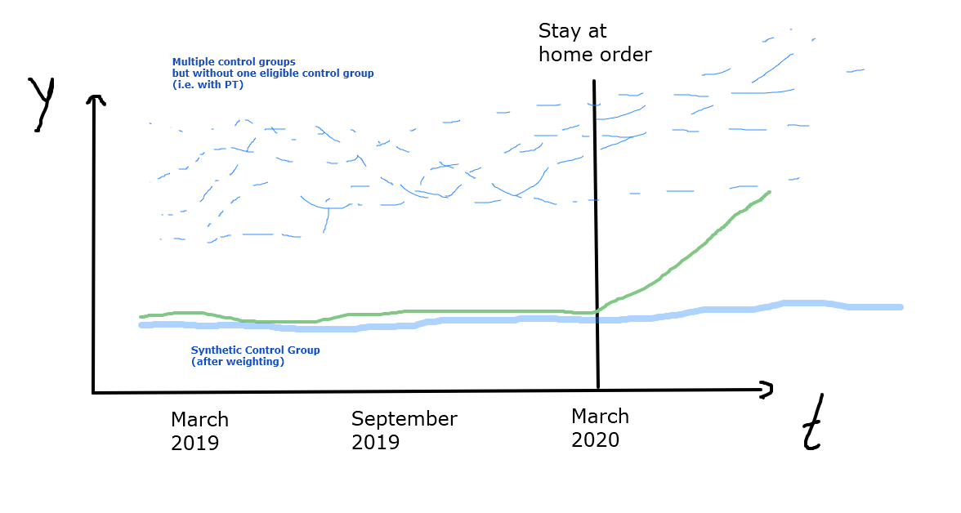
With multiple control groups

Slide 48
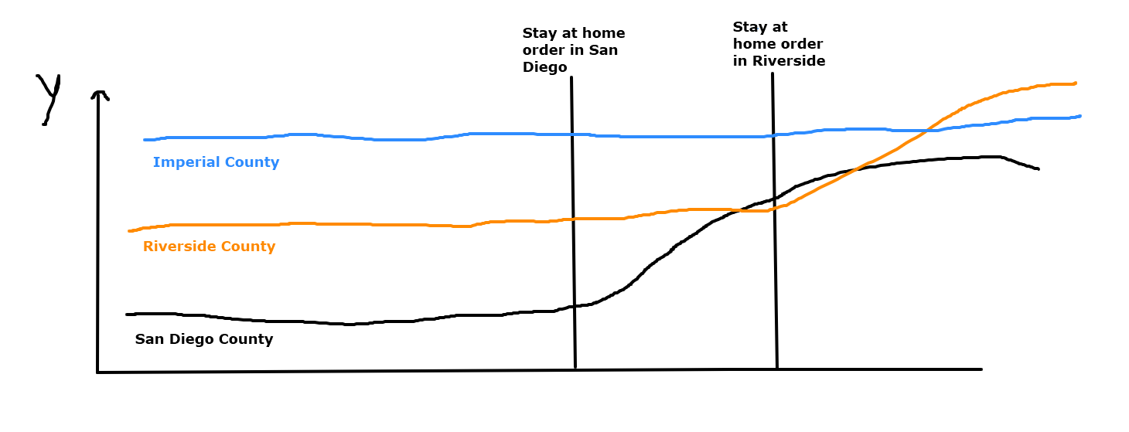
With variation in the timing of the intervention

Slide 49
Revisiting the workshop objectives
Understand the conceptual foundations of quasi-experimental methods based on the timing of a natural experiment
Understanding how Difference-in-Differences (DID), Interrupted Time Series (ITS) and Synthetic Control Methods (SCM) work and their specific identification assumptions.
Being able to implement (in R) DID, ITS and SCM in different settings, interpret estimands of interest and check/visualize possible assumptions’ violations
  Coming next

Slide 50
References
Craig, P., Katikireddi, S. V., Leyland, A., & Popham, F. (2017). Natural experiments: an overview of methods, approaches, and contributions to public health intervention research. Annual review of public health, 38, 39-56.
Abadie, A., Diamond, A., & Hainmueller, J. (2010). Synthetic control methods for comparative case studies: Estimating the effect of California’s tobacco control program. Journal of the American statistical Association, 105(490), 493-505.
Xu, Y. (2017). Generalized synthetic control method: Causal inference with interactive fixed effects models. Political Analysis, 25(1), 57-76.
Acemoglu, D., Johnson, S., Kermani, A., Kwak, J. and Mitton, T., 2016. The value of connections in turbulent times: Evidence from the United States. Journal of Financial Economics, 121(2), pp.368-391.
Dube A, Zipperer B. Pooled synthetic control estimates for recurring treatment: an application to minimum wage studies, University of Massachusetts. Amherst Working Paper.2013
Kreif, N., Grieve, R., Hangartner, D., Turner, A.J., Nikolova, S. and Sutton, M., 2016. Examination of the synthetic control method for evaluating health policies with multiple treated units. Health economics, 25(12), pp.1514-1528.
Goodman-Bacon, A. (2021). Difference-in-differences with variation in treatment timing. Journal of Econometrics.
Callaway, B., & Sant’Anna, P. H. (2020). Difference-in-differences with multiple time periods. Journal of Econometrics.
Roth, J., & Sant'Anna, P. H. (2020). When Is Parallel Trends Sensitive to Functional Form?. arXiv preprint arXiv:2010.04814.
Lipsitch, M., Tchetgen, E. T., & Cohen, T. (2010). Negative controls: a tool for detecting confounding and bias in observational studies. Epidemiology (Cambridge, Mass.), 21(3), 383.

Slide 51
Thank You niaroch@ucla.edu tbenmarhnia@ucsd.edu

